Slide 1
Working diagram and data sources
Nutrient diversity in the food system
Sold diversity
System diversity
Catch diversity
Consumption diversity
Nutrient diversity in household diets
Biomonitoring data
CFR-level
Catch and consumption monitoring data
Household-level
Nutrient database
Species-level

Slide 2
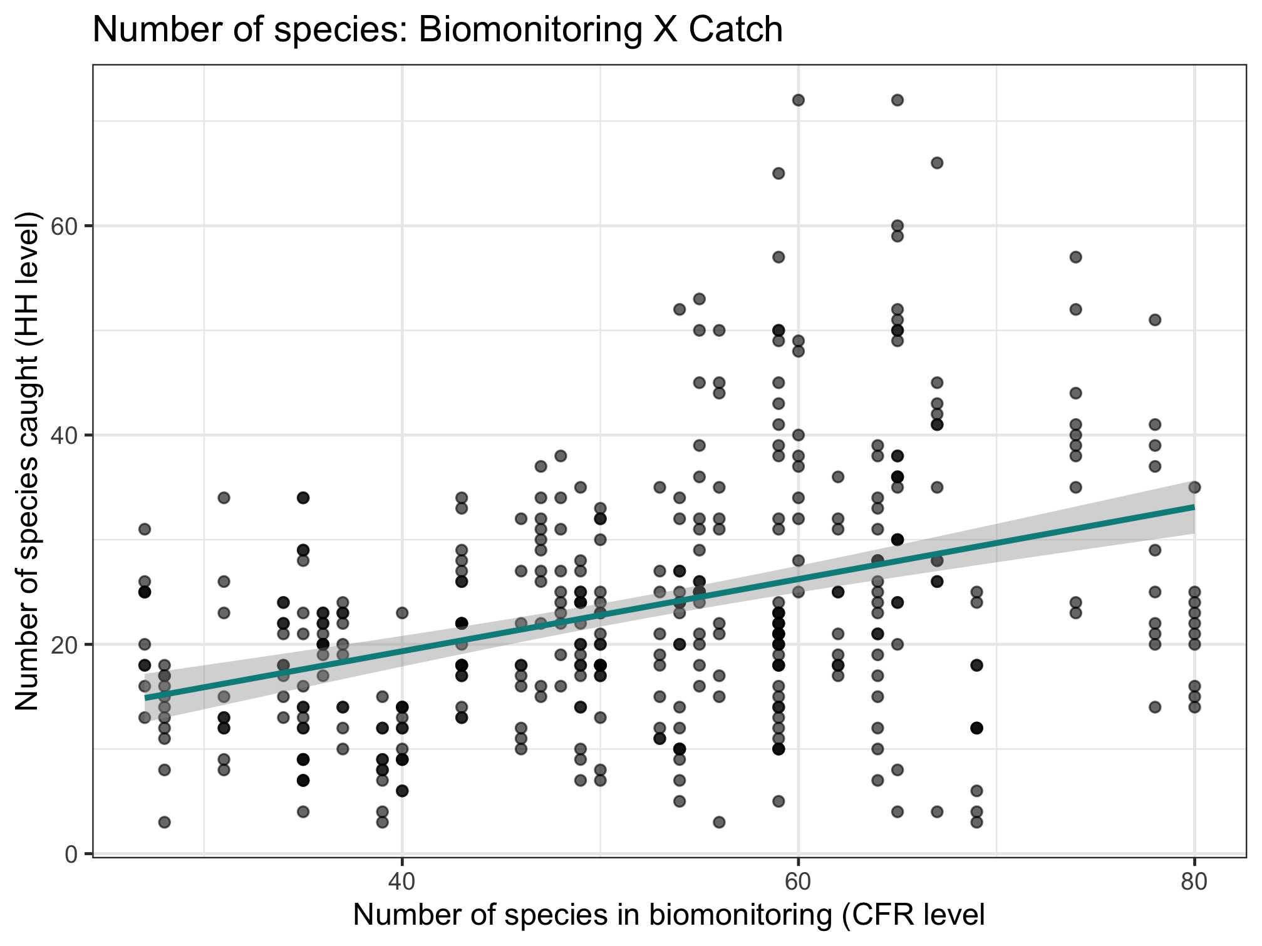
Nutrient diversity in the food system
Sold diversity
Slope = 0.384
System diversity
Catch diversity
Consumption diversity
Nutrient diversity in household diets

Slide 3
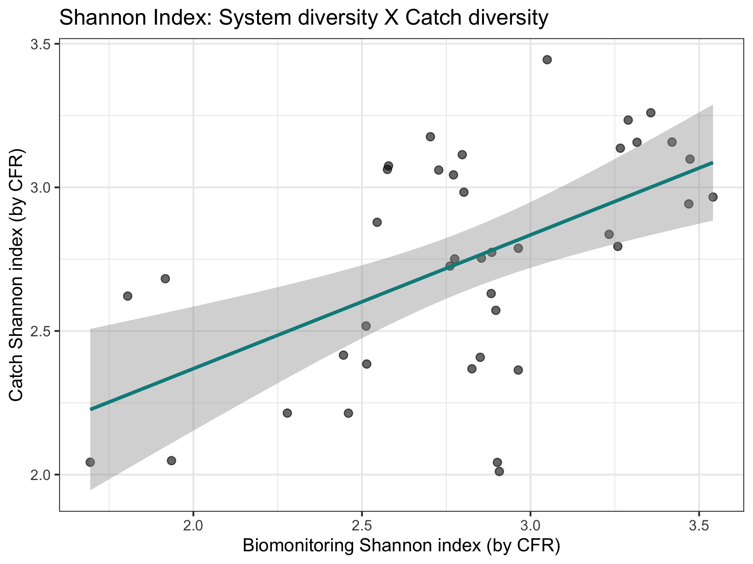
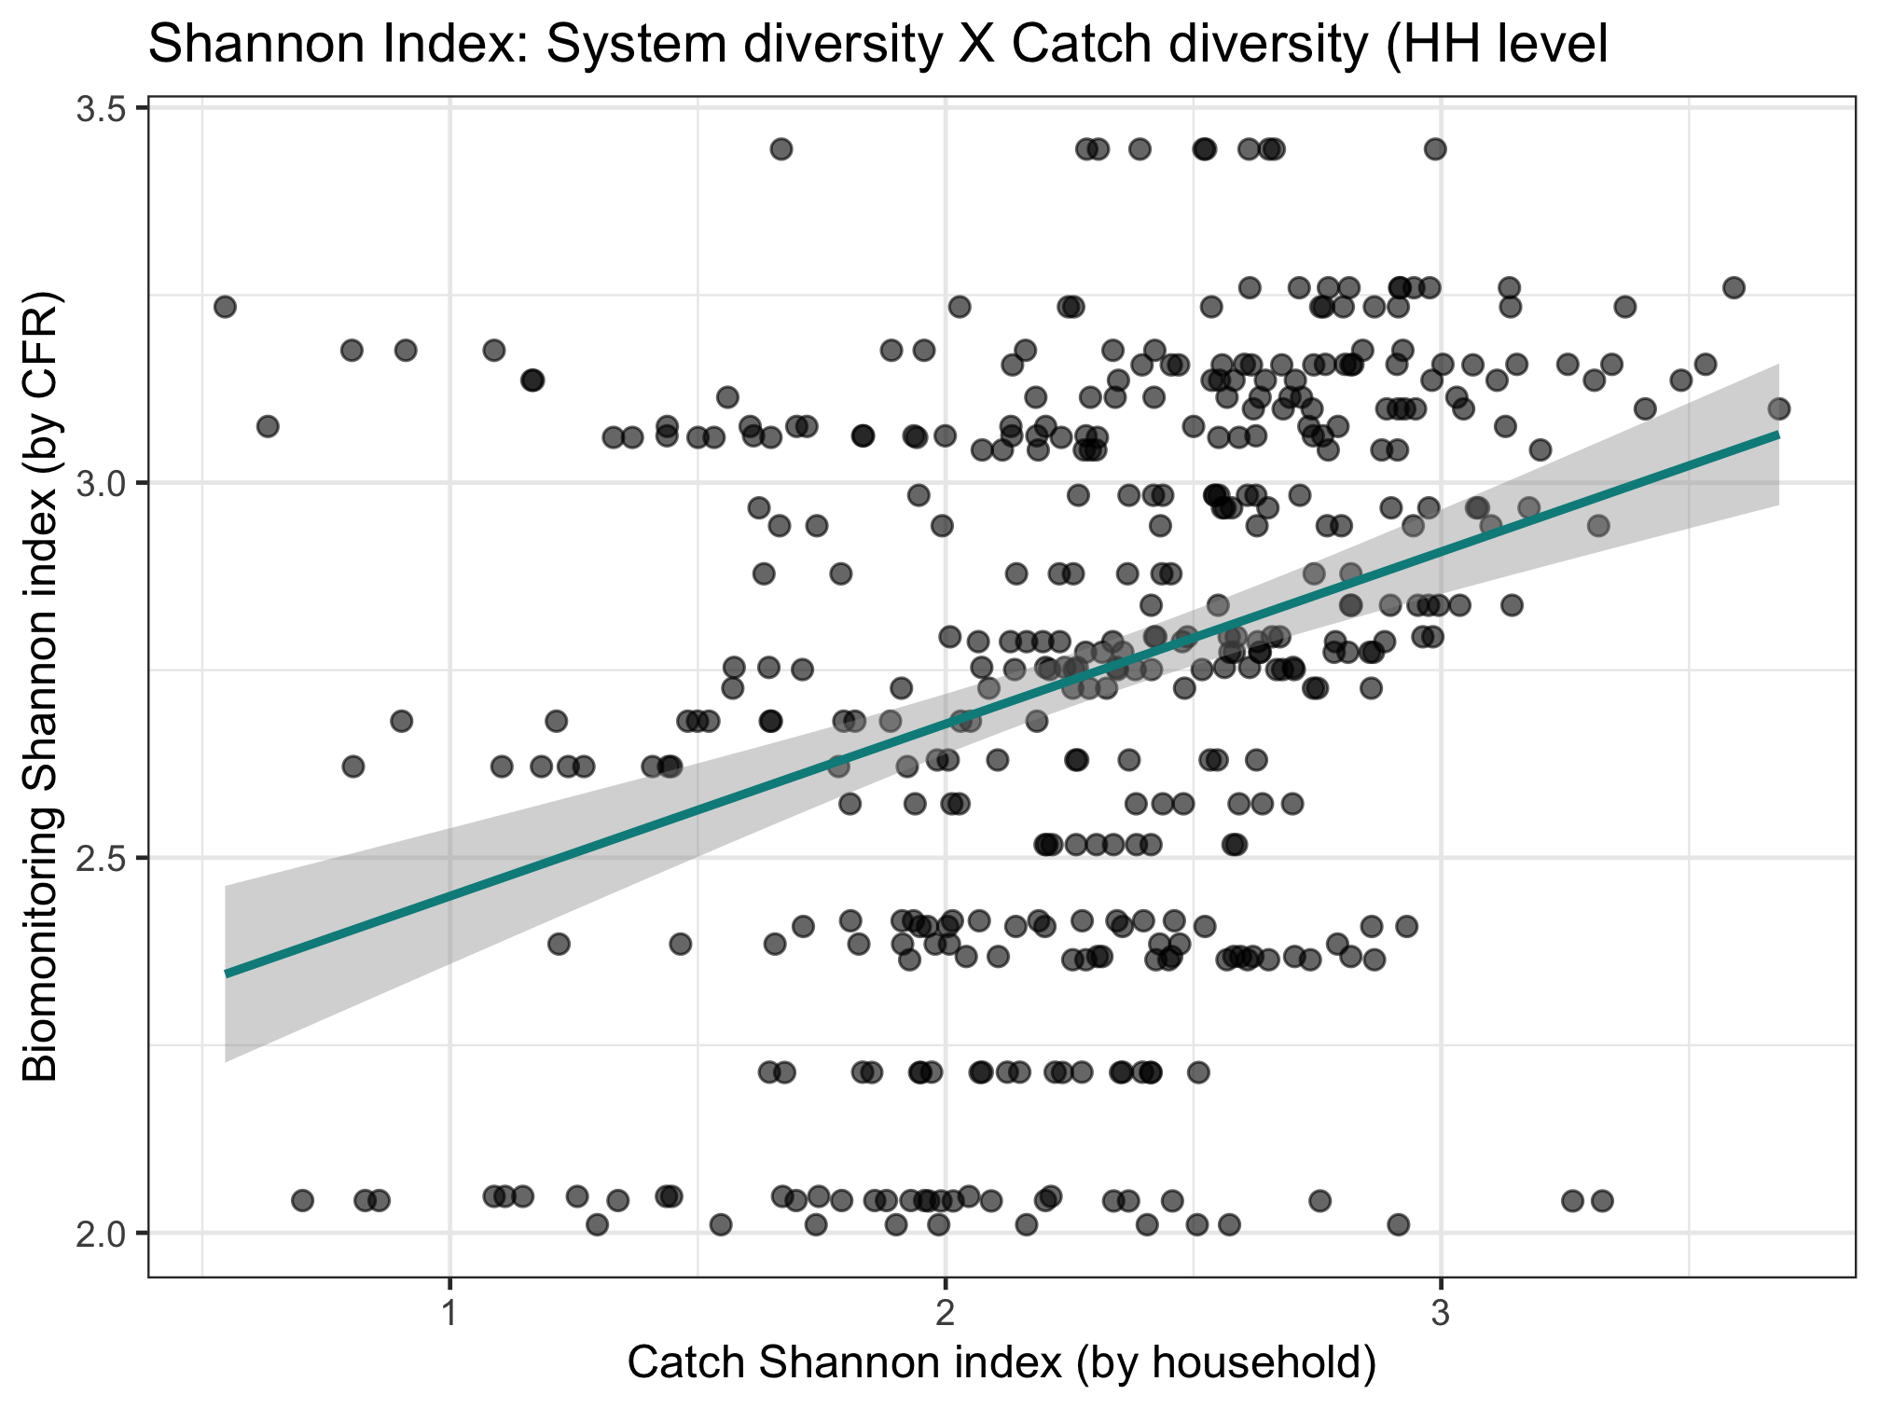
Color code by CFR type, maybe CFR size
Nutrient diversity in the food system
Sold diversity
Slope = 0.486
System diversity
Catch diversity
Consumption diversity
Nutrient diversity in household diets
Slope = 0.376

Slide 4
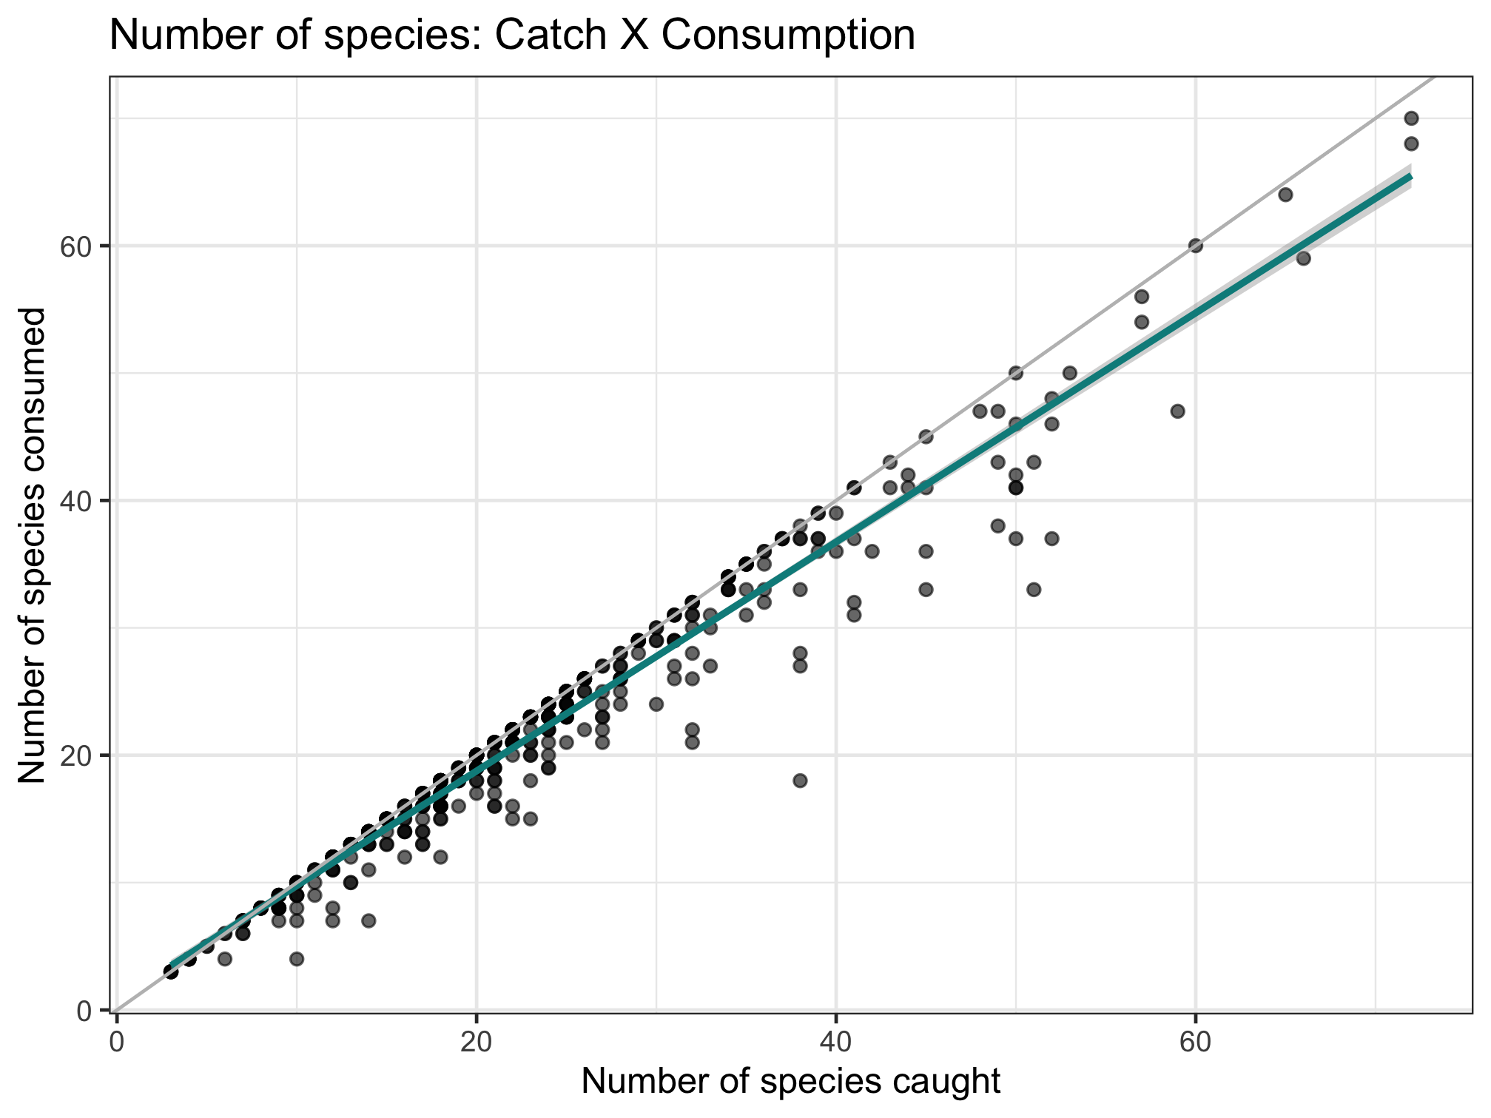
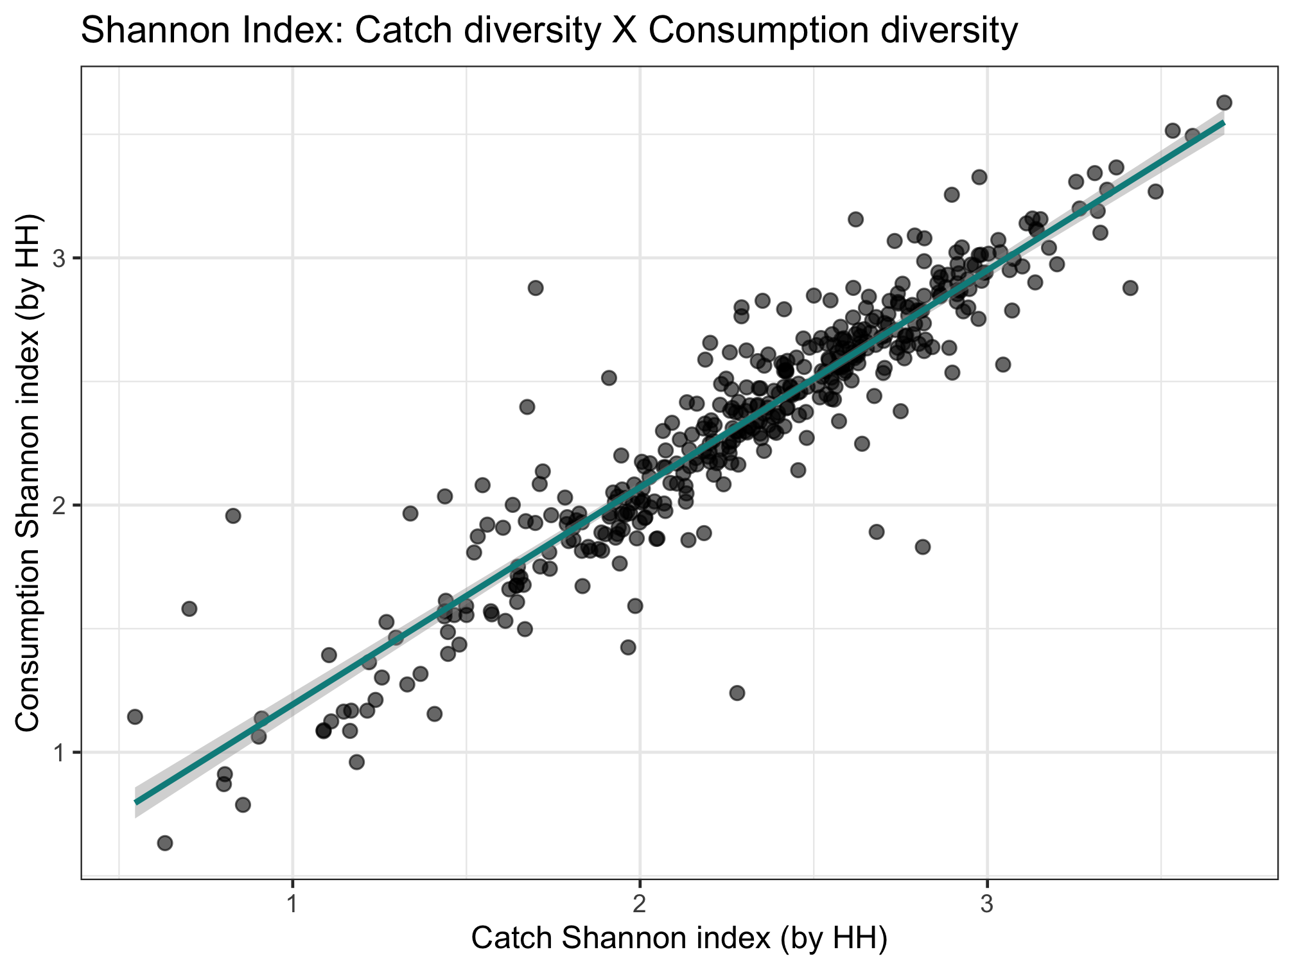
Nutrient diversity in the food system
Sold diversity
Slope = 0.979
System diversity
Catch diversity
Consumption diversity
Nutrient diversity in household diets
Slope = 0.924

Slide 5
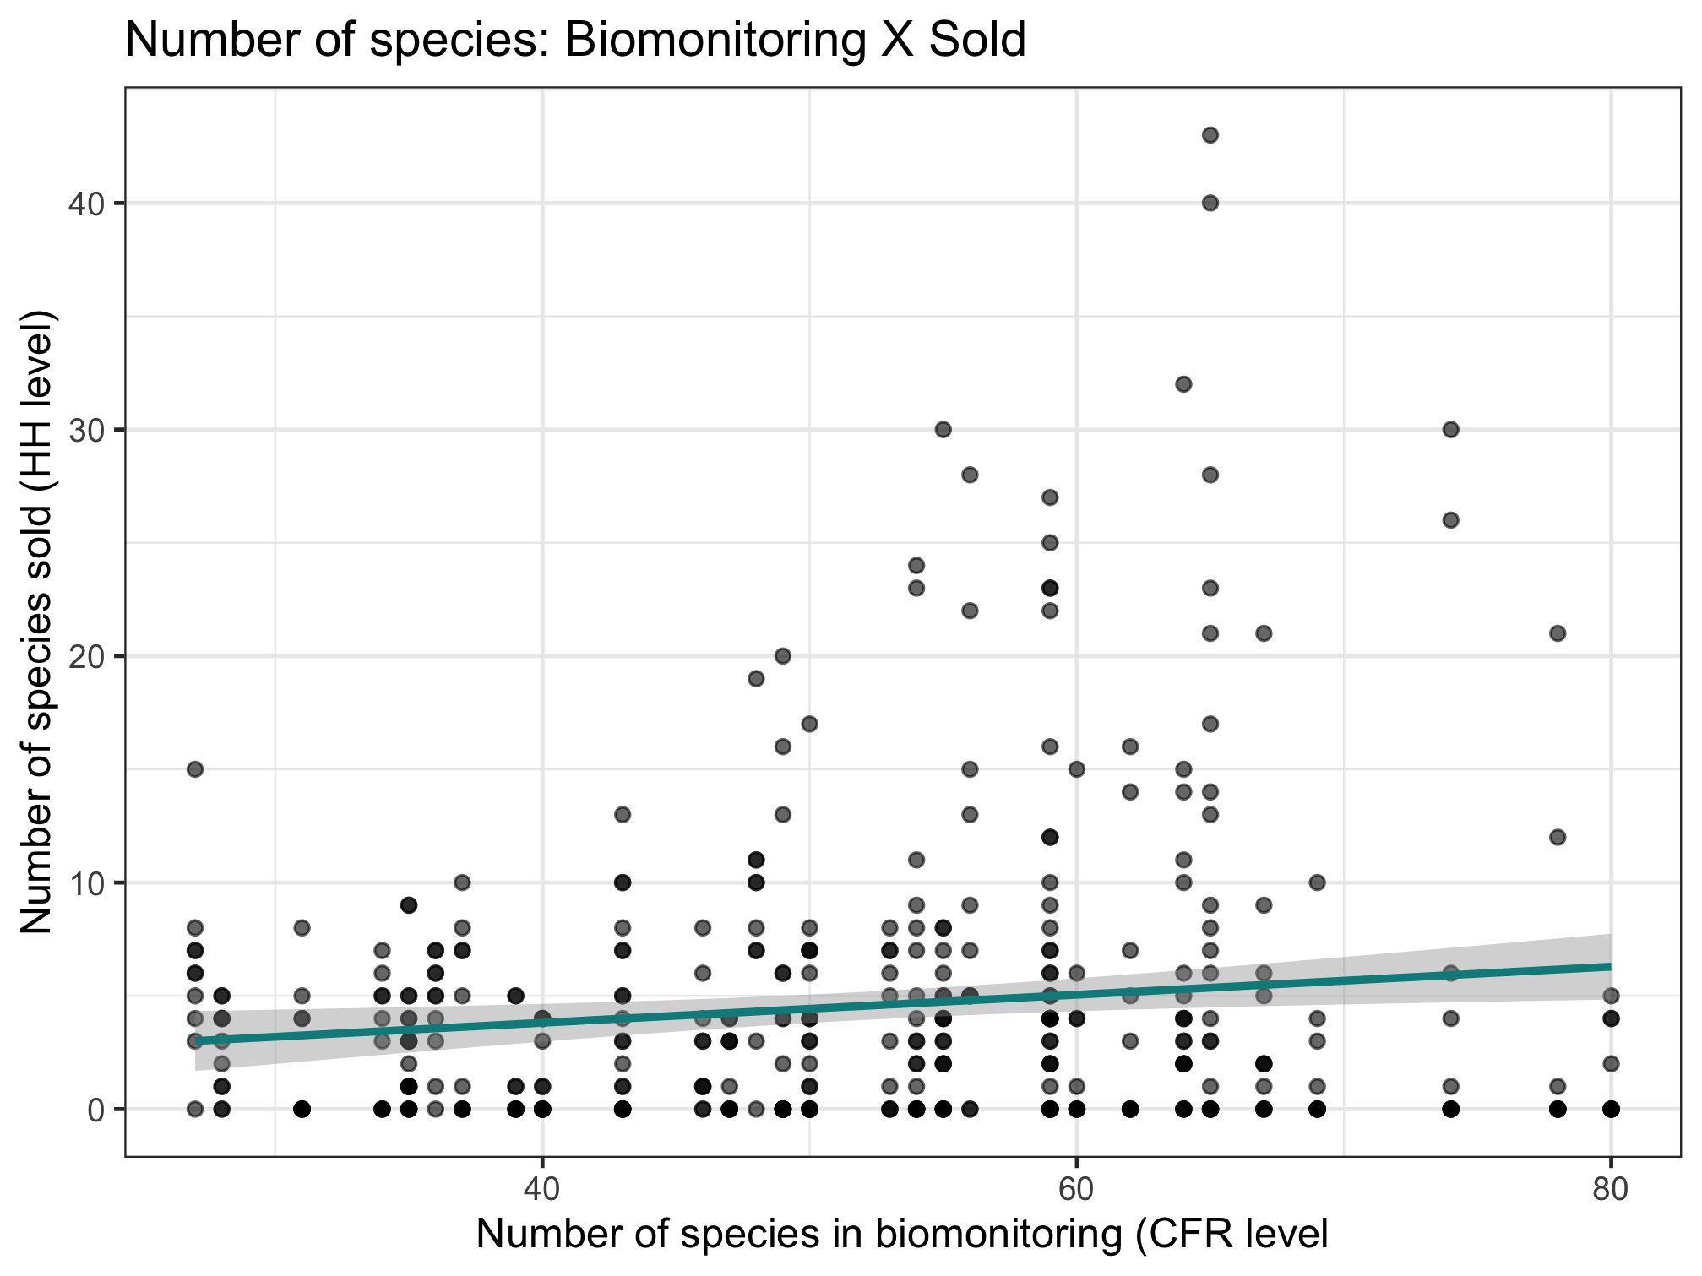
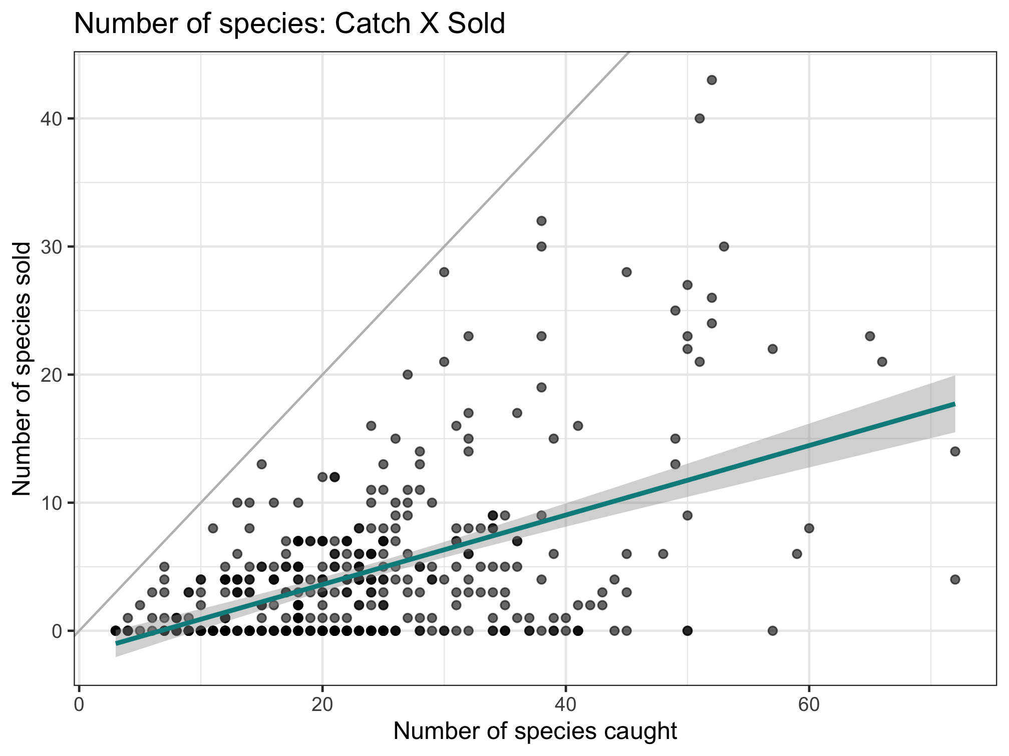
Nutrient diversity in the food system
Sold diversity
System diversity
Catch diversity
Consumption diversity
Nutrient diversity in household diets
Slope = 0.397

Slide 6
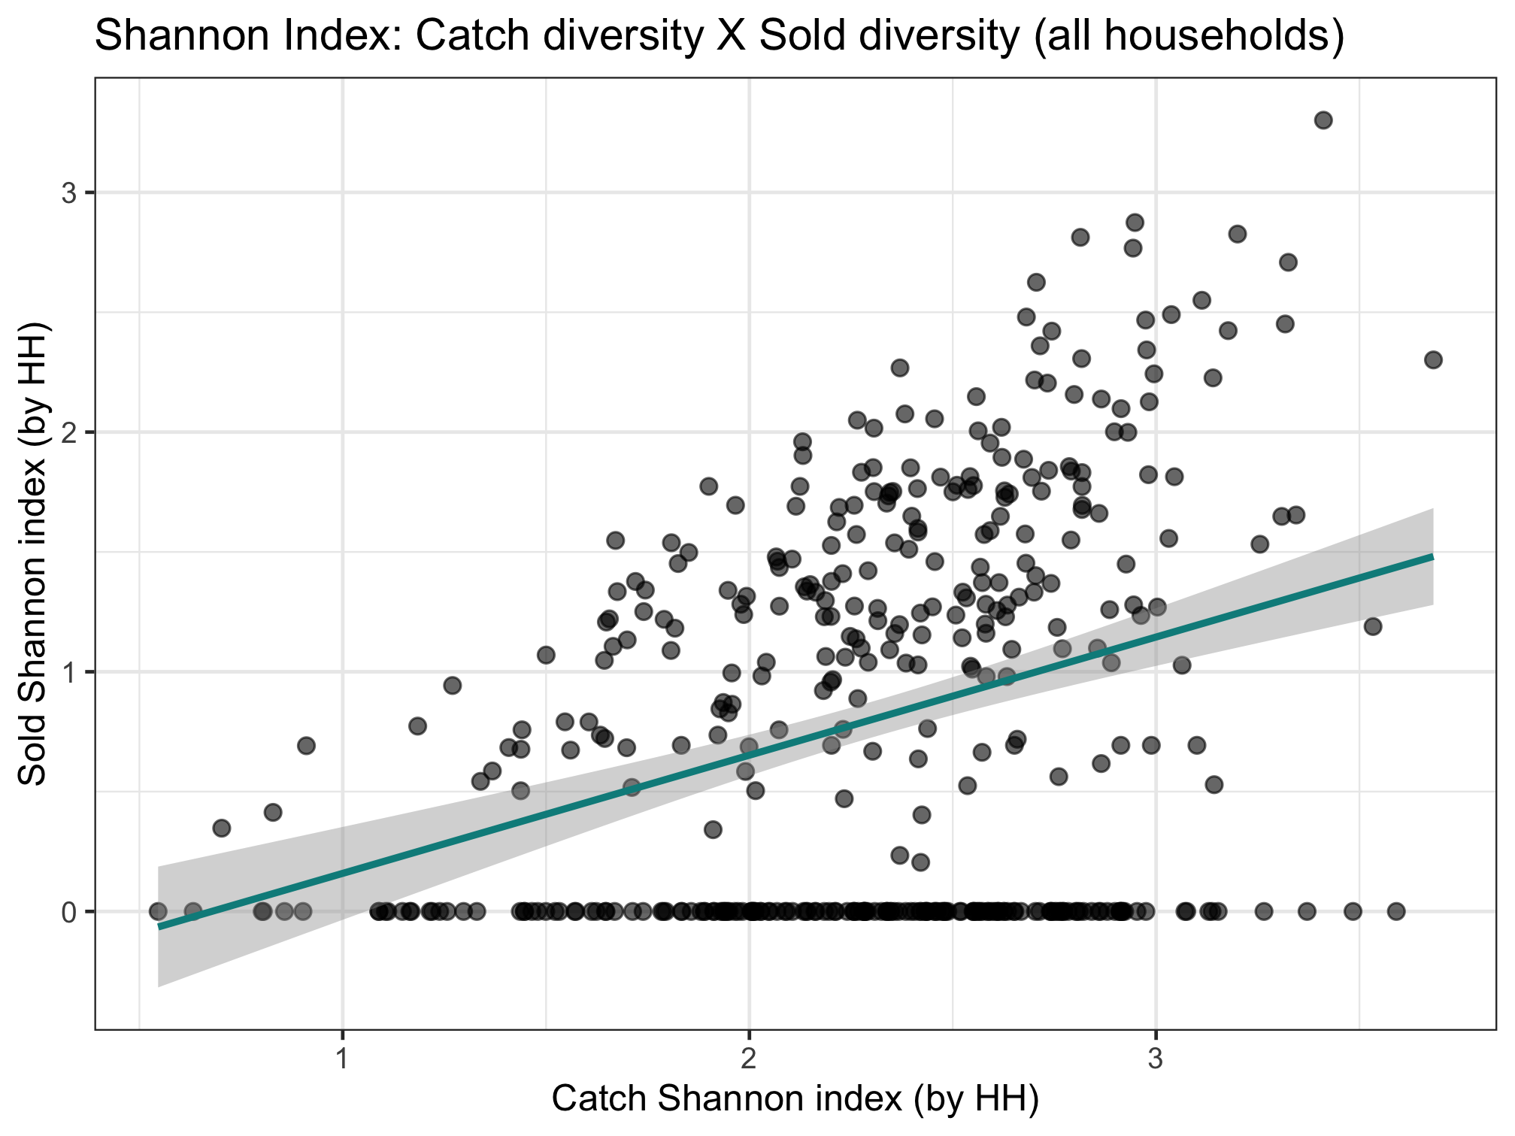
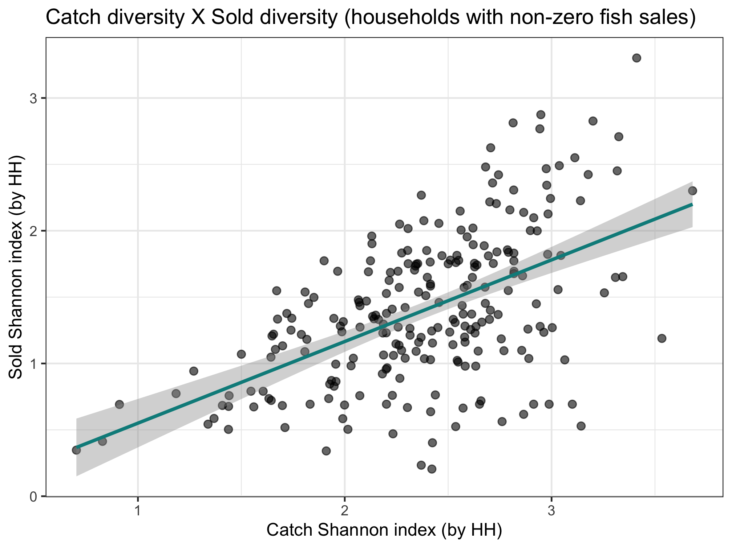
Key point:
Sold species are selective.
Catch and consumption are in lock step. Much accounting includes only sold, which isn't as linked to what is in the ecosystem. Disprefered sale species are underrecognized
Nutrient diversity in the food system
Sold diversity
Slope = 0.287
System diversity
Catch diversity
Consumption diversity
Nutrient diversity in household diets
Slope = 0.493

Slide 7
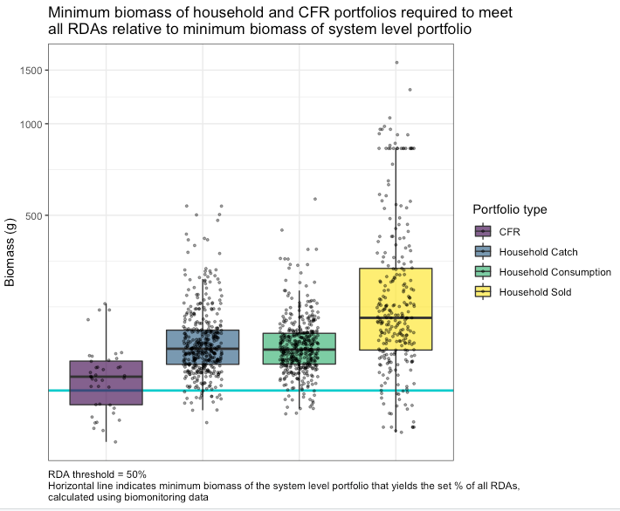
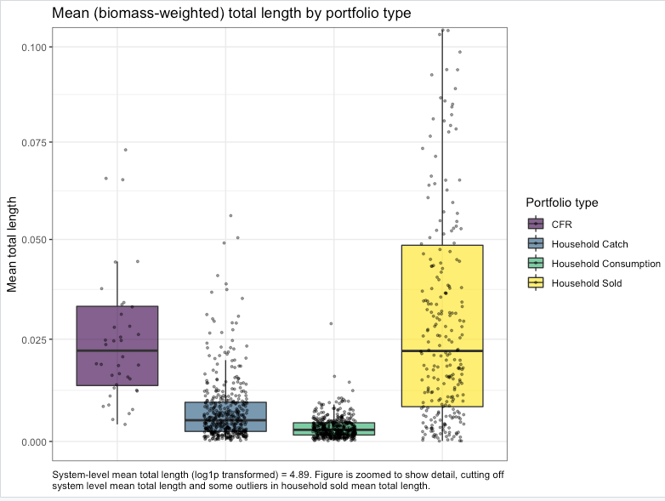
Get rid of legend. Color points by number of species.

Slide 9
Past graphs and notes…

Slide 10
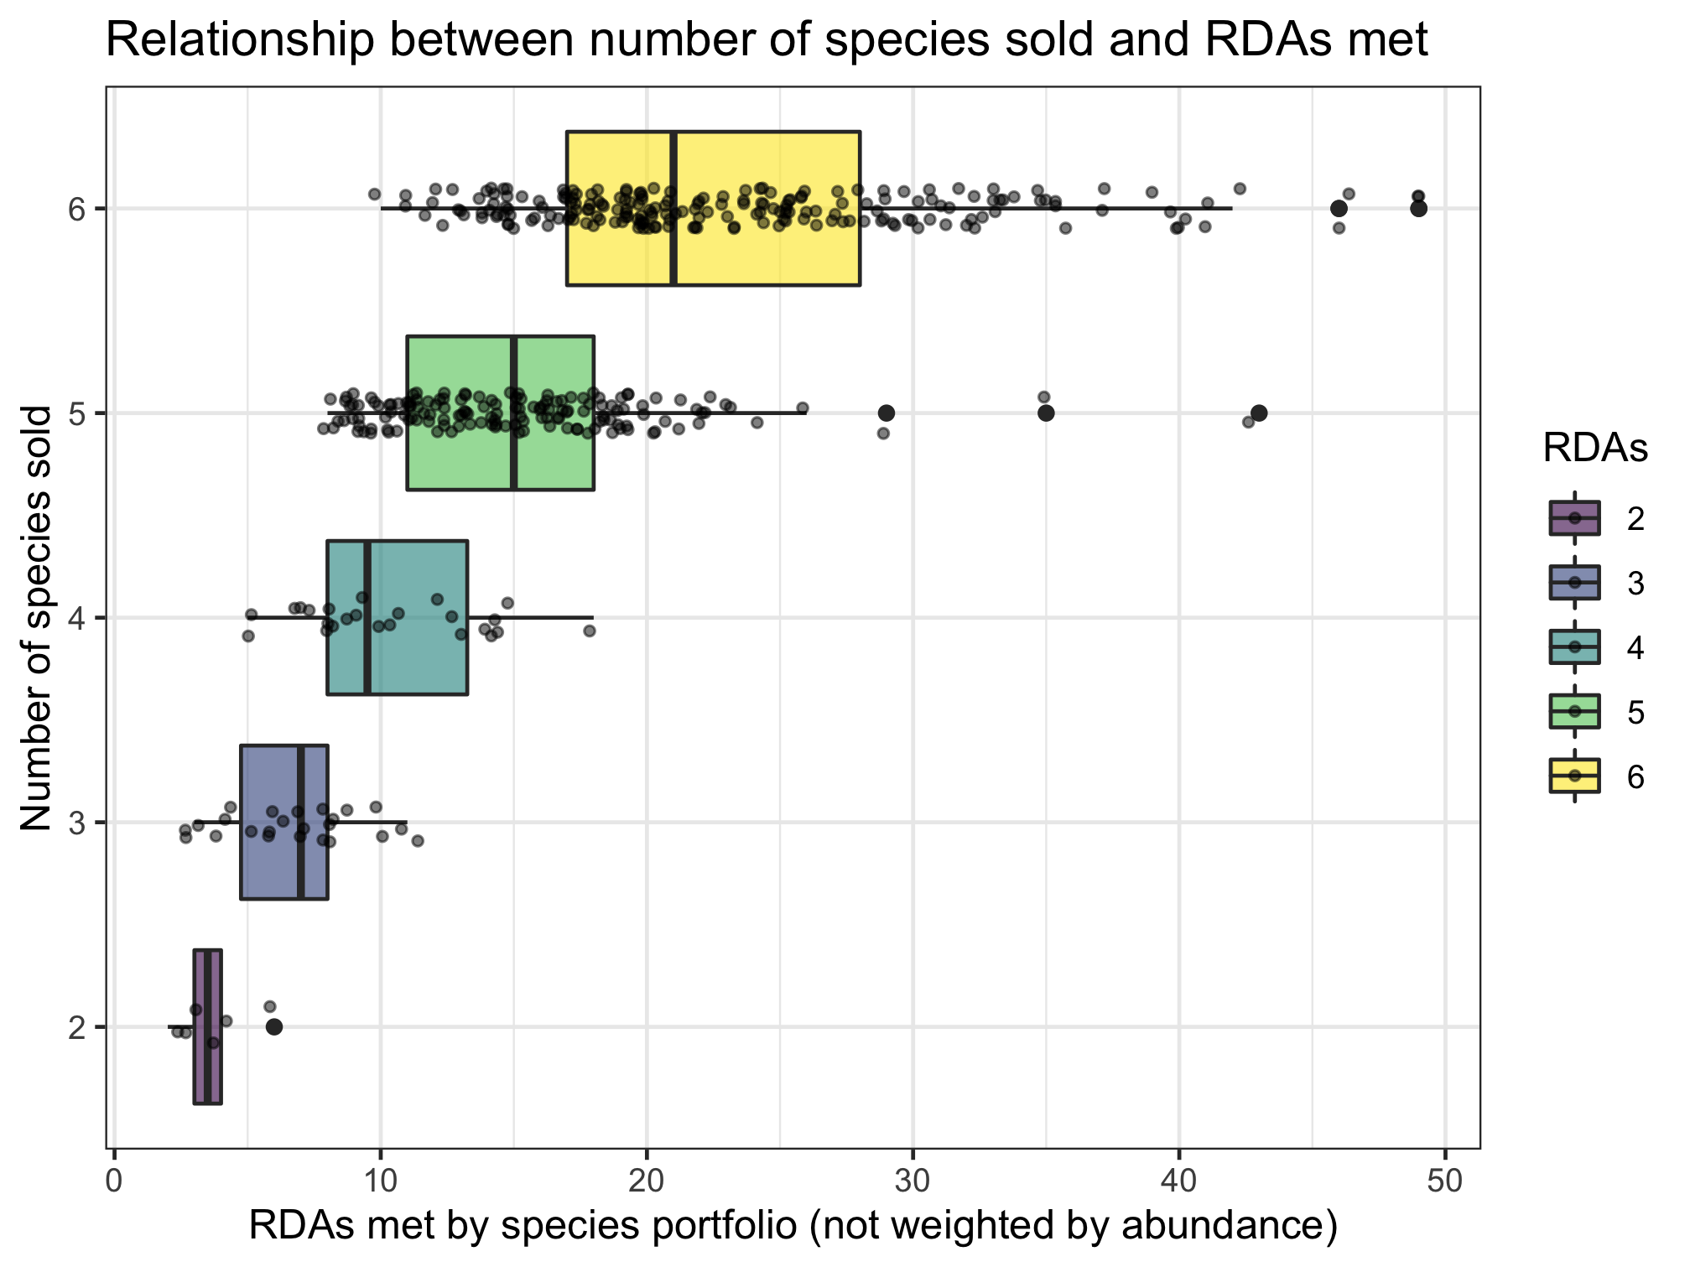
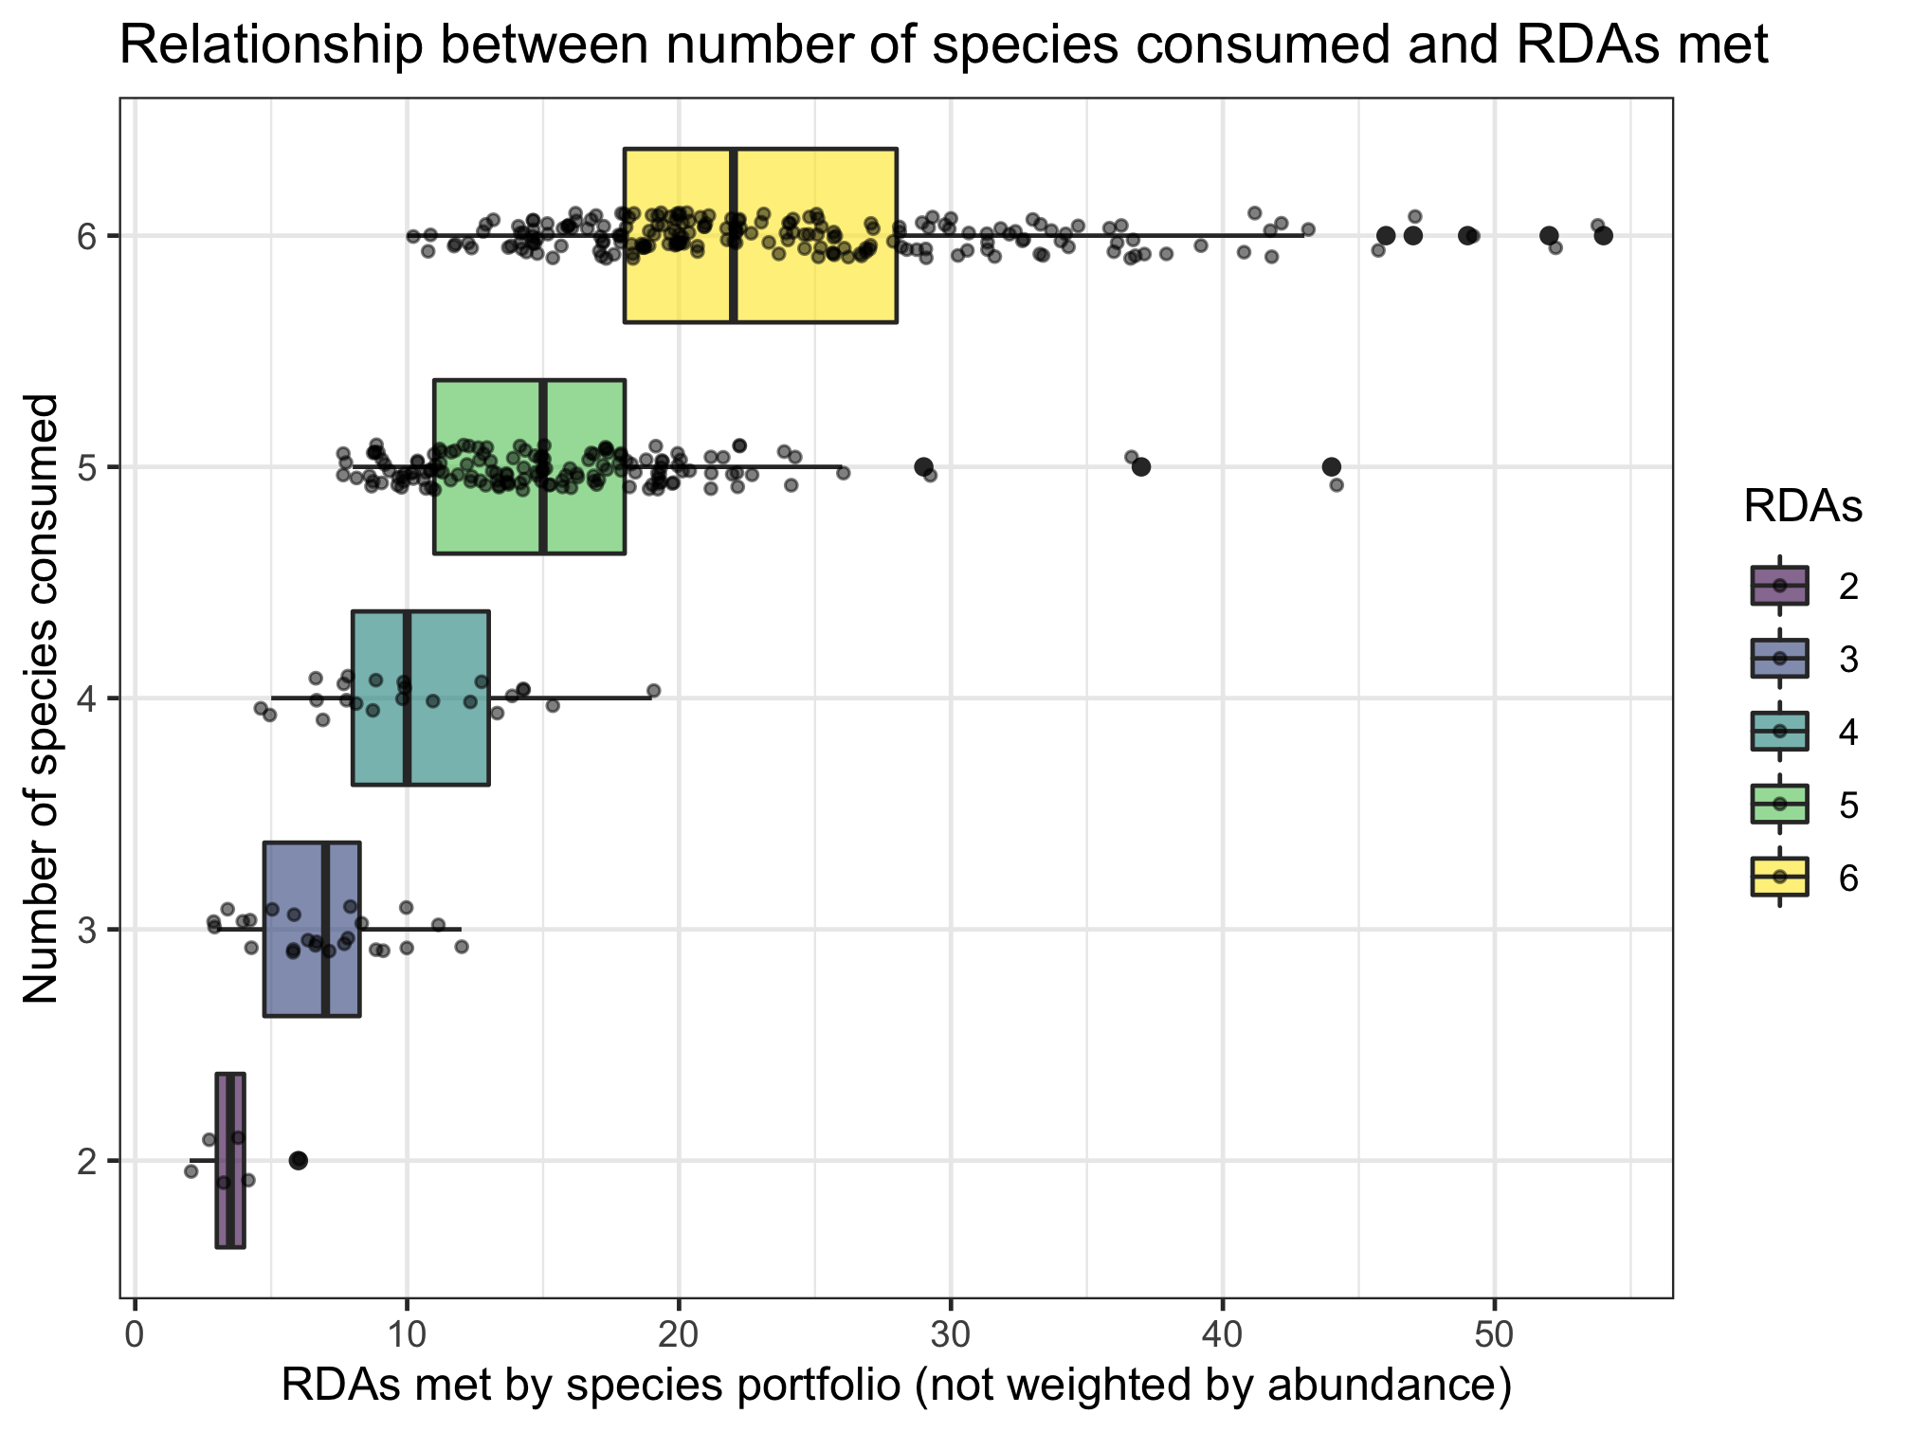
Nutrient diversity in the food system
Sold diversity
System diversity
Catch diversity
Consumption diversity
Nutrient diversity in household diets
Slopes if RDAs treated as continuous:
0.701 (sold)
0.697 (consumed)

Slide 11
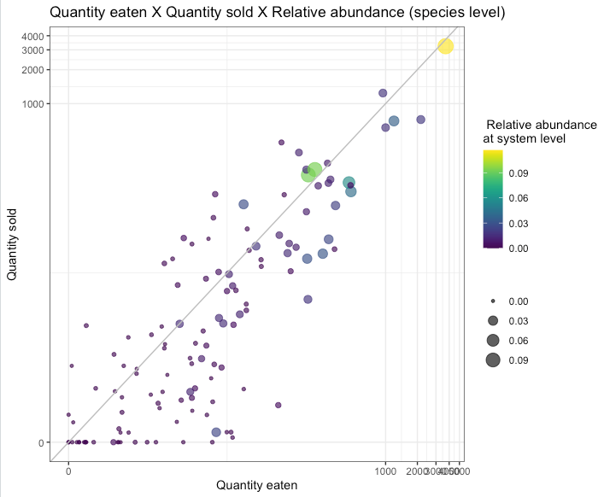
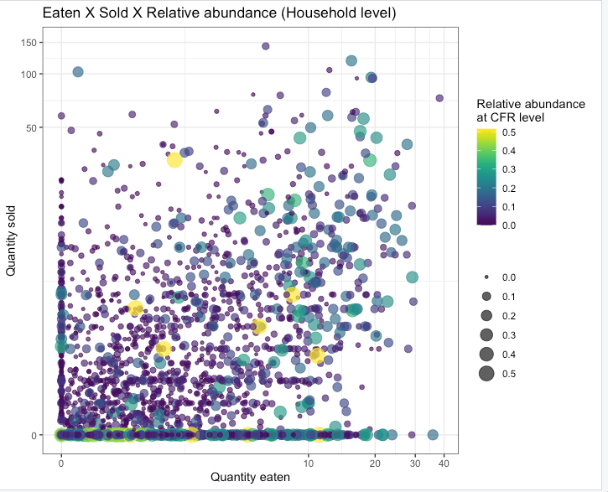
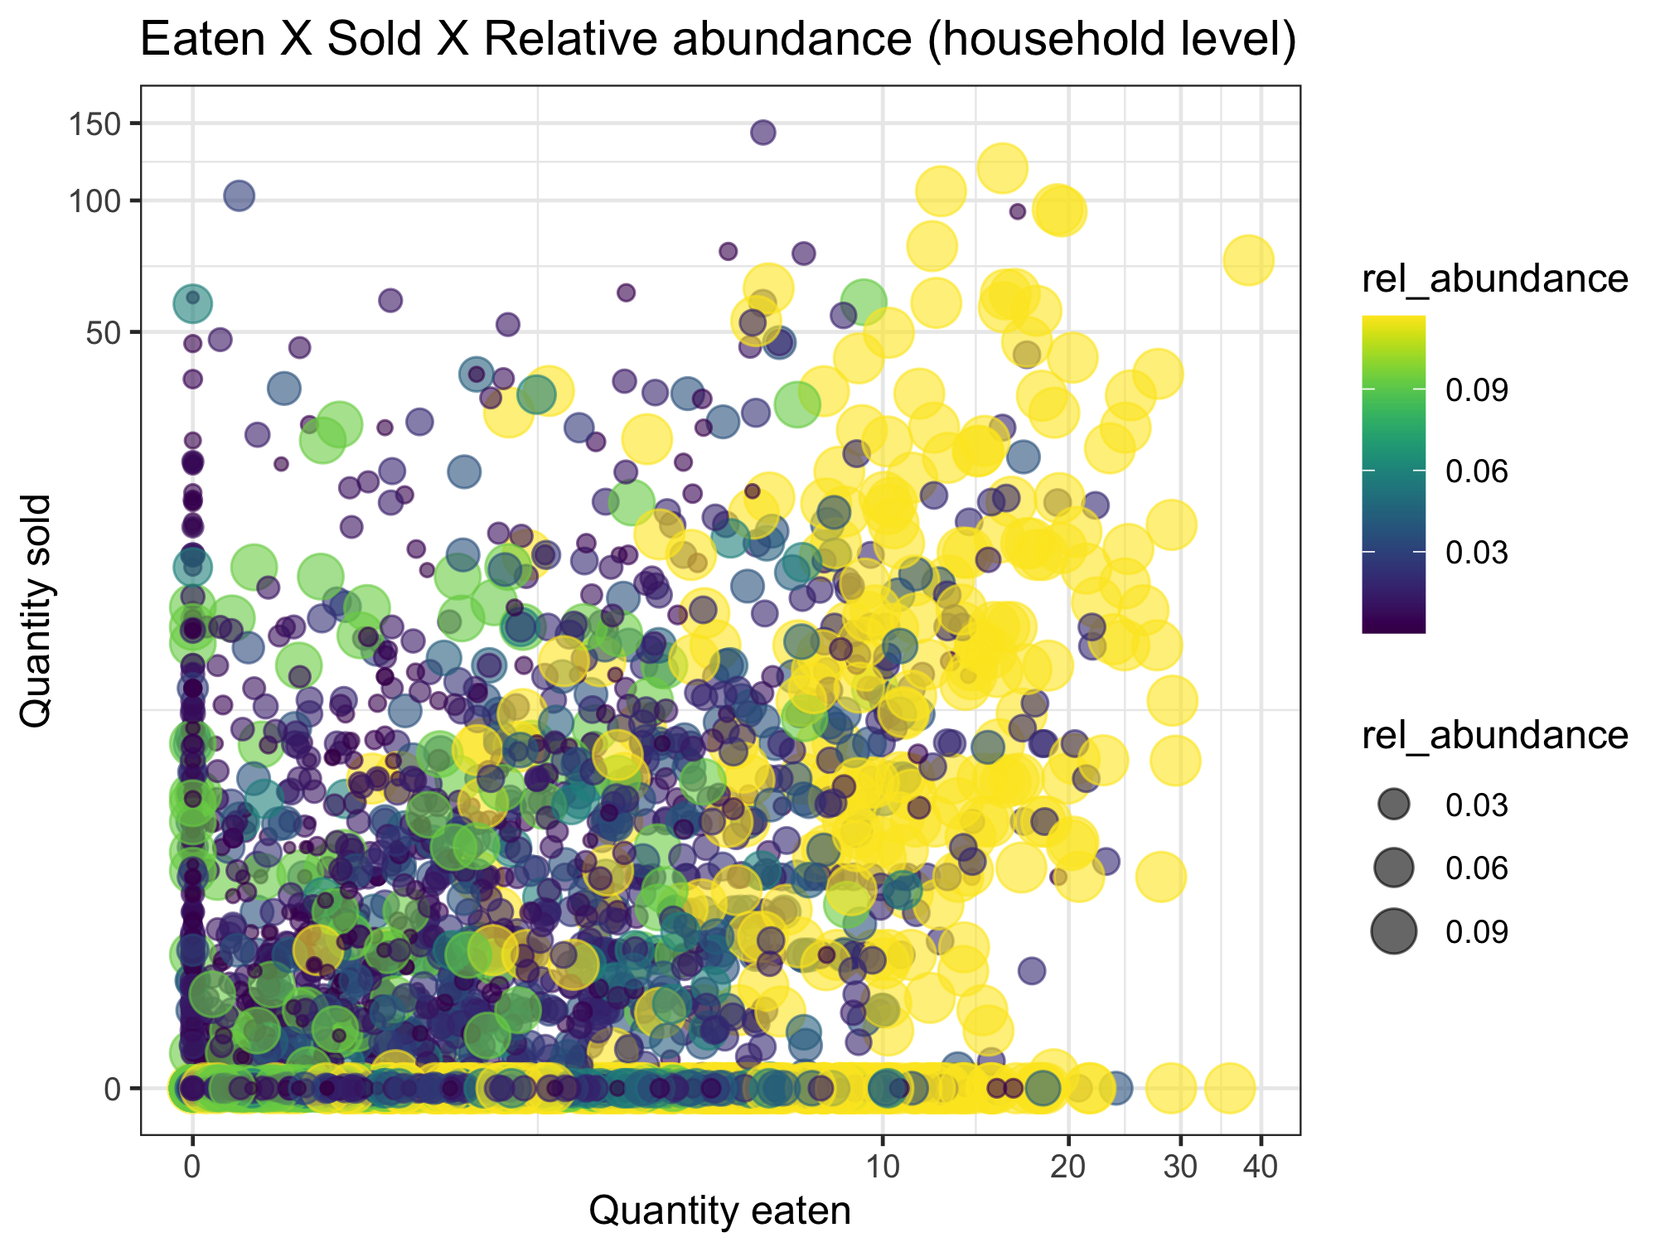
This uses relative abundance at the system level.
Nutrient diversity in the food system
Sold diversity
System diversity
Catch diversity
Consumption diversity
Nutrient diversity in household diets
Conclusion: abundance doesn’t necessarily drive sale or consumption

Slide 12
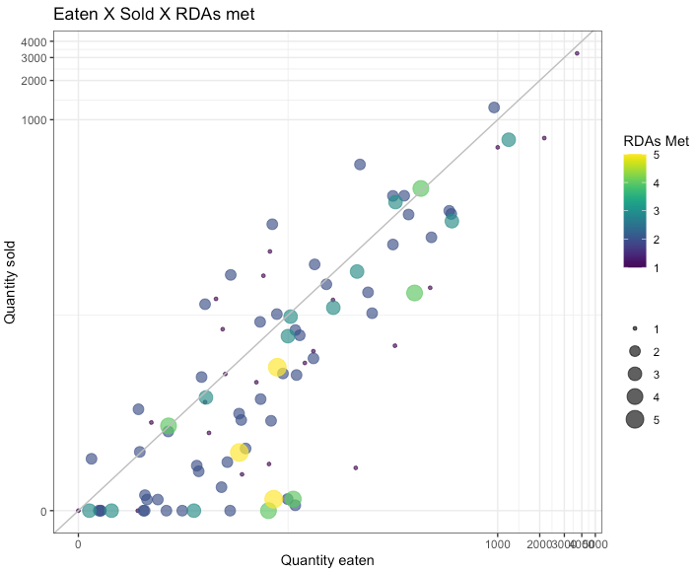
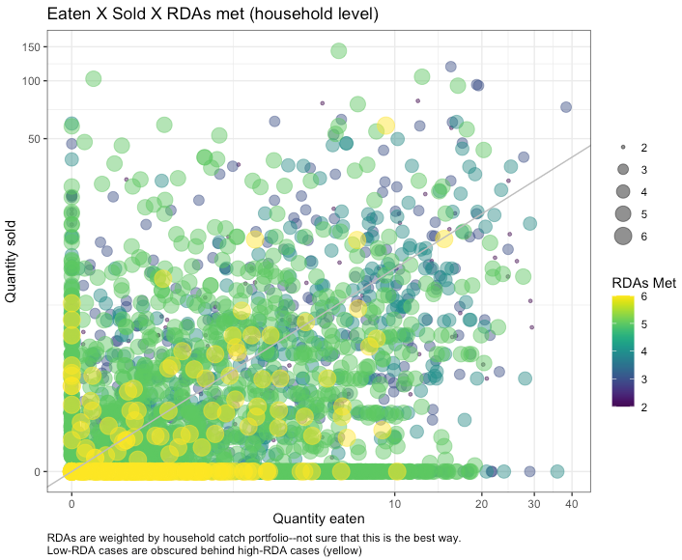
Nutrient diversity in the food system
Sold diversity
System diversity
Catch diversity
Consumption diversity
Nutrient diversity in household diets
Is this a small fish effect?
Yellow (high RDA) means whatever the last nutrient is (VitA or calcium (small fish)
We wanted to weight the RDAs by relative abundance, but within which portfolio level? These are weighted by household-level catch portfolio. Need to think more about the implications of this.
Low-RDA fish are obscured by high-RDA fish. Sorting differently doesn’t help much, but highlights that there are many low-RDA fish along the X axis.
Maybe this should be plotted at a higher level (e.g. CFR?)

Slide 13
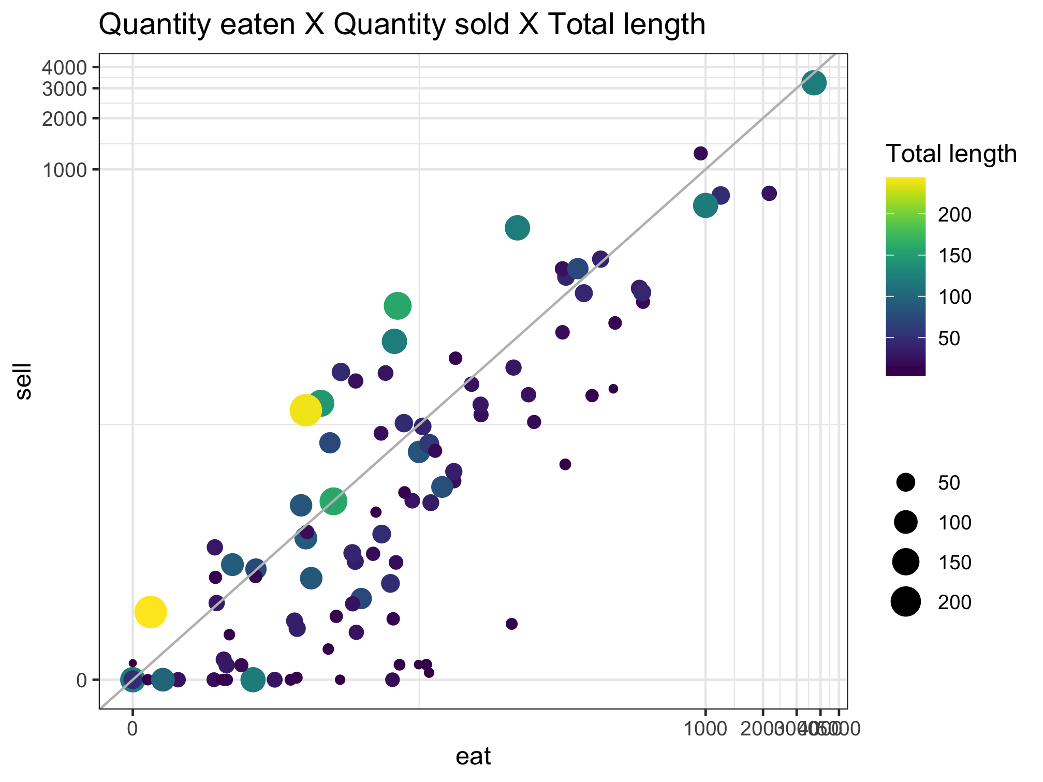
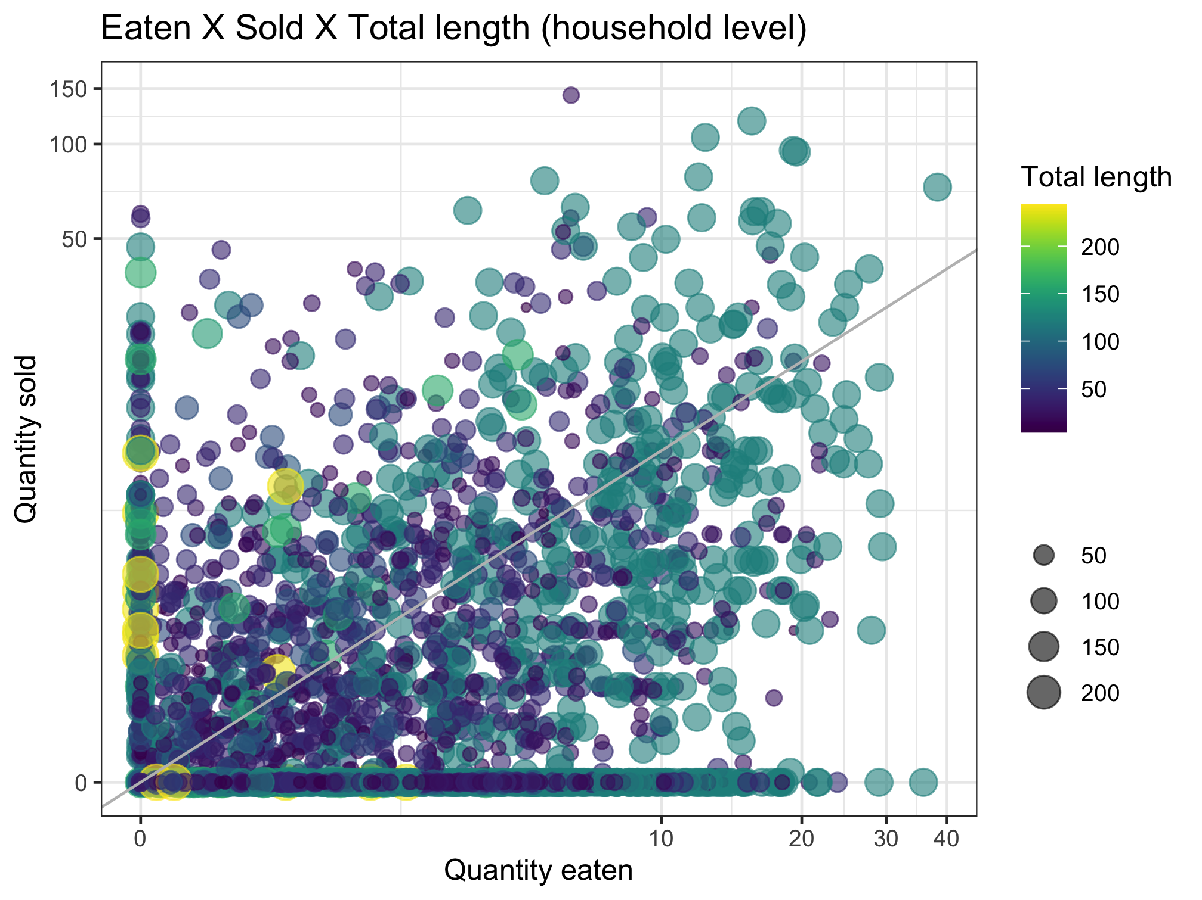
Nutrient diversity in the food system
Sold diversity
System diversity
Catch diversity
Consumption diversity
Nutrient diversity in household diets

Slide 14
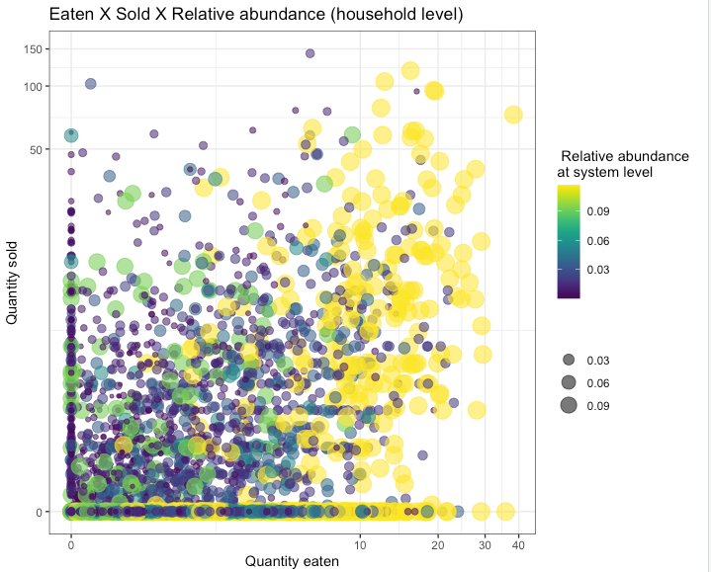
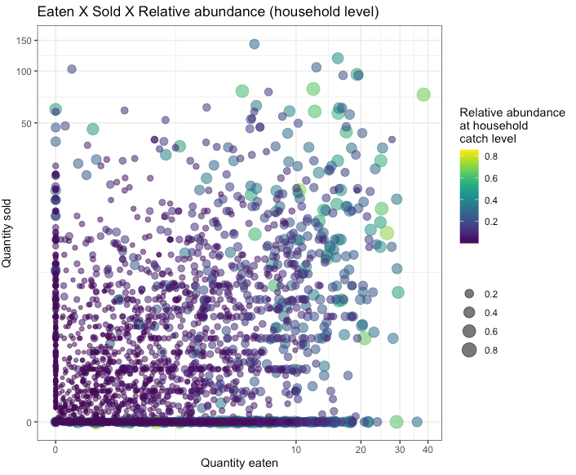
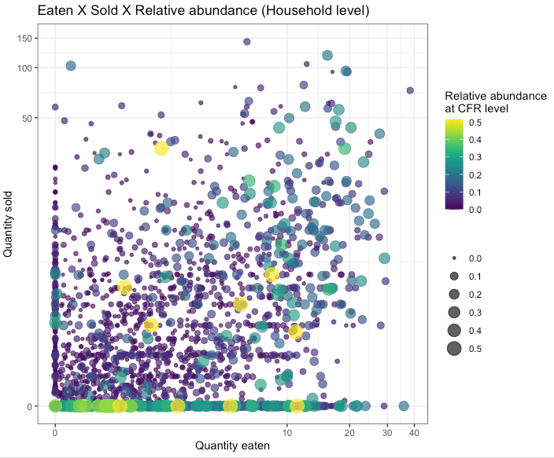
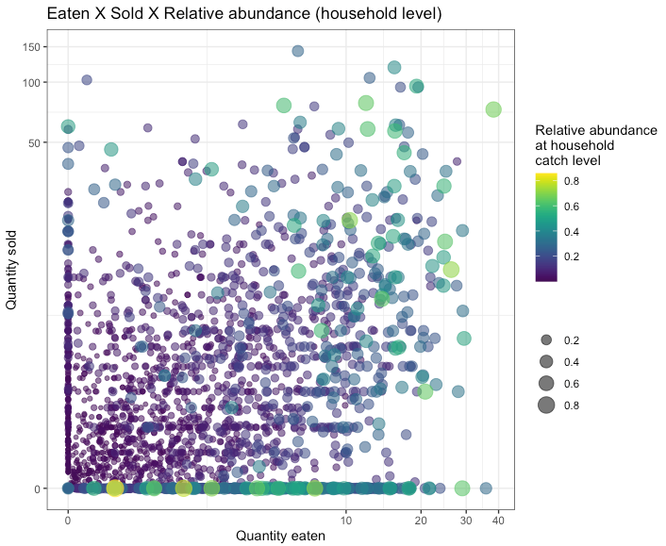
Question: Does species abundance matter for the decision between selling and eating?
Relative abundance in the system
Relative abundance in CFR
Relative abundance in household catch
More abundant species appear to be eaten more than sold. Scatter plots may not tell whole story.
Next slide unpacks this further.
Same as above, but with reverse sorting so high abundance is more visible
Same as above, but with reverse sorting so high abundance is more visible

Slide 15
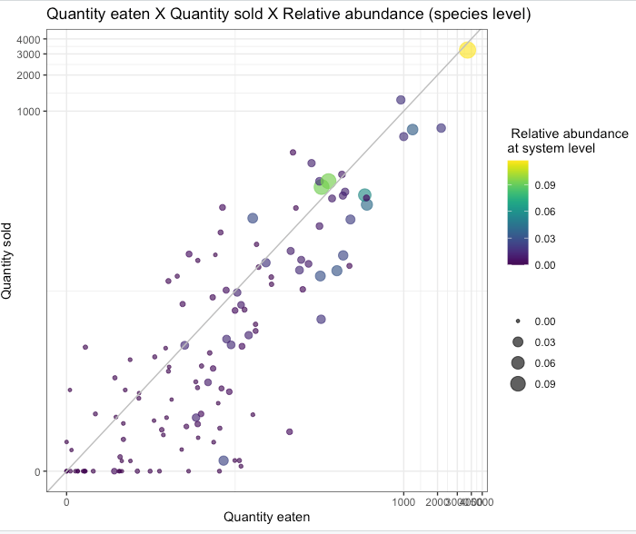
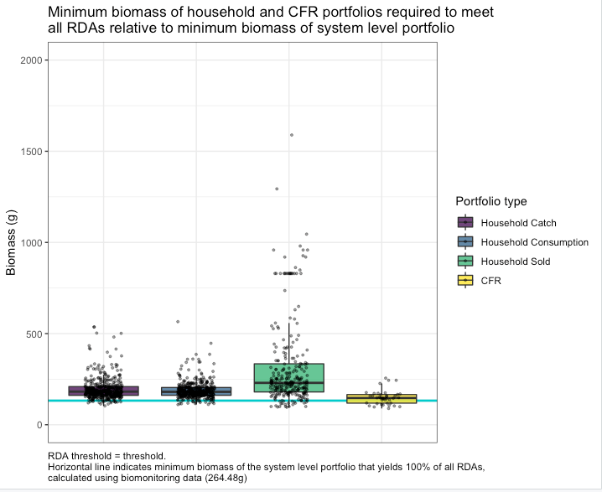
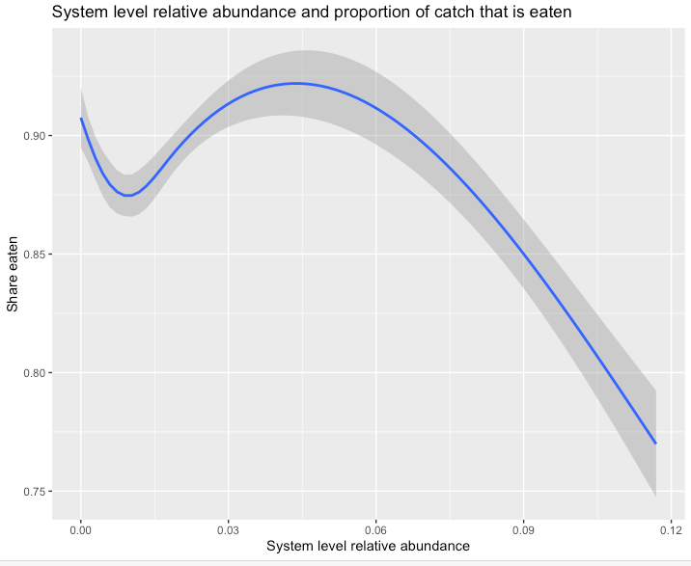
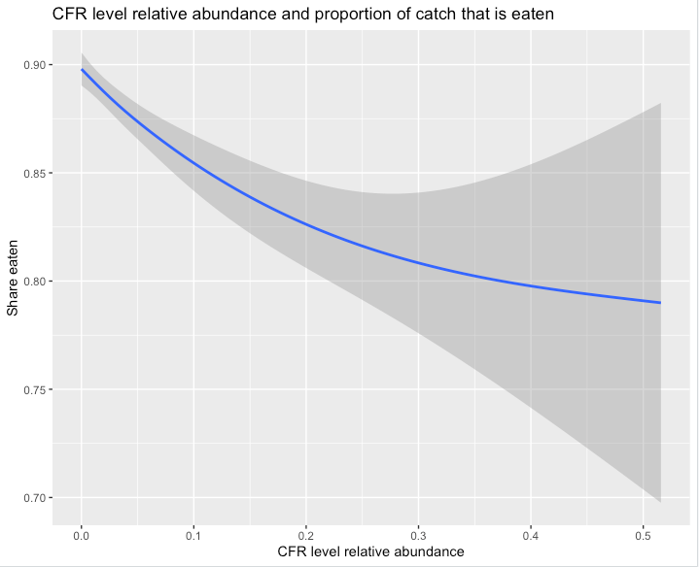
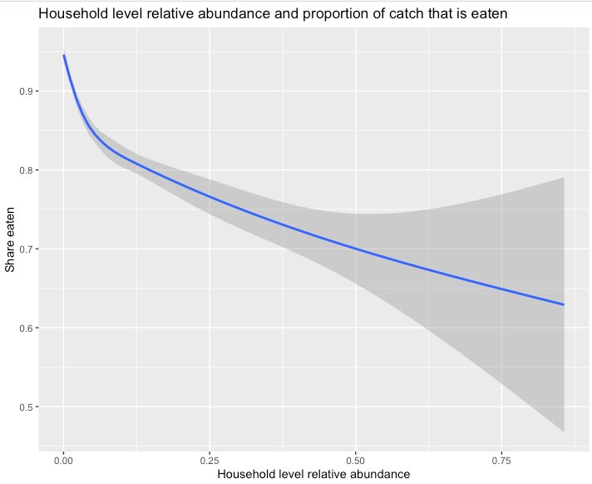
Question: Does species abundance matter for the decision between selling and eating?
Relative abundance in the system
Relative abundance in CFR
Relative abundance in household catch
Spearman correlation coefficient between abundance and share eaten = -0.107
Spearman correlation coefficient between abundance and share eaten = -0.129
Spearman correlation coefficient between abundance and share eaten = -0.275

Slide 16
Sebastian’s thoughts 20220929
Nestedness is a method
Filtering is a process
Framing should be around filtering, with nestedness as a tool that we might use to understand it
“Community assembly to understand the filters that apply from fish available in the environment to fish available on people’s plates”

